Slide 1
Industrial Psychology
Industrial - Organizational (I - O) Psychology & Individual Differences

Slide 2
In this unit
Nature and scope of I-O Psychology
Importance
I-O Psychology - past, present and future
Multicultural and cross-cultural issues
Introduction to individual differences - identification and varieties
Human attributes and abilities
Personalities and work behaviour
Big five and other models of personality
Job analysis and performance - Campbell model
Types of performance measures and organizational citizenship behaviour
Types of job analysis and competency modelling

Slide 3
What is Industrial - Organizational (I - O) Psychology?
Martin Luther King, Jr., captured the essence of good work eloquently: “If a man is called to be a street sweeper, he should sweep streets even as Michelangelo painted, Beethoven composed music, or Shakespeare wrote poetry. He should sweep streets so well that all heaven and earth will pause to say, ‘Here lived a great street sweeper who did his job well’” (King, 1956).
Industrial-organizational (I-O) psychology is the application of psychological principles, theory, and research to the work setting.
The specialty of industrial-organizational psychology (also called I/O psychology) is characterized by the scientific study of human behavior in organizations and the workplace. The specialty focuses on deriving principles of individual, group and organizational behavior and applying this knowledge to the solution of problems at work. (American Psychological Association)

Slide 4
Nature and scope
The specialty of Industrial Organizational Psychology addresses issues of
Recruitment
Selection and placement
Training and development
Performance measurement
Workplace motivation and reward systems
Quality of work life
Structure of work and human factors
Organizational development
Consumer behavior.

Slide 5
Traditional divisions
I-O psychology has been traditionally divided into three major concentrations: personnel psychology, organizational psychology, and human engineering.
Personnel psychology (often seen as part of human resources management, or HRM) addresses issues such as recruitment, selection, training, performance appraisal, promotion, transfer, and termination. The approach assumes that people are consistently different in their attributes and work behaviors and that information about these differences can be used to predict, maintain, and increase work performance and satisfaction.
Human engineering (also called human factors psychology) is the study of the capacities and limitations of humans with respect to a particular environment. The human engineering approach is almost the opposite of the personnel approach.

Slide 6
Organizational psychology combines research and ideas from social psychology and organizational behavior. It addresses the emotional and motivational side of work. It includes topics such as attitudes, fairness, motivation, stress, leadership, teams, and the broader aspects of organizational and work design. In some senses, it concentrates on the reactions of people to work and the action plans that develop as a result of those reactions. Both work and people are variables of interest, and the issue is the extent to which characteristics of the people match the characteristics or demands of the work. Of course, organizational psychology has implications for performance, but they may not be as direct as is the case with personnel psychology.

Slide 7
I - O Psychology - Past, Present and Future

Slide 8
Past - important timeline
1888 - Cattell measures individual differences
1890 - Cattell develops the first Mental Test
1892 - Munsterberg arrives at Harvard - American Psychological Association founded
1913 - Munsterberg publishes first English text in I-O Psychology
1917 - World War I: Scott and Bingha enlist in Army and develop group intelligence test, Lillian Gilbreth was awarded first I-O PhD
1923 - Mayo arrives in United States
1930 - Mayo publicizes the Hawthorne studies
1932 - Viteles publishes first modern text in I-O Psychology
1941 - World War II: Human Engineering applied to solve aircraft accidents
1945 - I-O Psychology becomes Division 14 of American Psychological Association
1950 - Explosion of commercial tests
1964 - Civil Rights Act - Title VII

Slide 9
Present
1988 - Association for Psychological Science was founded to serve the needs of the more experimental and theoretical areas of psychology. (to promote, protect, and advance the interests of scientifically oriented psychology in research, application, teaching, and the improvement of human welfare)
APA founded in 1892 has more than 50 divisions that represent different types of psychologists; Division 14 of APA represents SIOP.
In 2012, I-O psychologists represented approximately 4 percent of all members of the APA, and approximately 8,600 I-O psychologists (including approximately 4,000 students) were members of Division 14.
There is also a major shift / increase
in the number of Masters and PhD programmes offered by American Higher Education Institutions
Gender of the I-O psychologists and
The salary structure of the I-O psychologists

Slide 10
Future
Since the opportunities for I-O psychology is increasing to contribute to employers, workers and the broader society, I_O psychology needs to meet four challenges.
I-O psychology needs to be relevant. This means that we need to study the problems of today, not those of yesterday. That is not to say that earlier research was misguided or “wrong,” but rather that older research gives us a foundation for newer research and application.
I-O psychology needs to be useful. I-O psychology, like counseling, school/educational, and clinical psychology, is an applied subdiscipline. The value the discipline adds is in putting our theories and research findings into action. I-O psychologists must always be thinking of ways to put our research into practice.

Slide 11
I-O psychology needs to think bigger. In the past, I-O psychology concentrated on the behavior of single individuals and tended to shy away from larger issues such as poverty, unemployment, globalization, and workforce diversity.
I-O psychology needs to be grounded in the scientific method. The confidence that society has in I-O psychology depends on this. Careful and systematic observation, the development of hypotheses that can be tested, the public collection and analysis of data, and a logical connection between the data and the interpretations of these data are the bases for our “reputation” in research and practice.
The goal of I-O psychology is to conduct / apply pragmatic research (important topic with well-designed research)

Slide 12
Multicultural and cross-cultural issues
Culture is a system in which individuals share meanings and common ways of viewing events and objects. As the world of work brings together people of many different nationalities (and, more important, cultures), the opportunities for misunderstandings and ineffective or counterproductive human resource applications grow as the number of different cultures grows. Consider the findings of some I-O research studies:
1. Asians have a very different understanding of time than Americans (Brislin & Kim, 2003).
2. In considering who gets a bonus and how much, Chinese managers make decisions based more on the personal needs of the individual, whereas in the United States, these decisions are based more on the performance of that individual (Zhou & Martocchio, 2001).

Slide 13
3. Compared to American managers, Japanese managers are much more likely to solve a strategic problem by being cooperative and making sure that individuals share equally in rewards (Wade-Benzoni et al., 2002).
4. Japanese managers are much more likely to seek compromise solutions than their American counterparts, who tend to follow win–lose strategies (Gelfand et al., 2001).
5. Shame as a result of a poor salesperson–customer interaction motivates salespersons from the Philippines but demotivates their Dutch counterparts (Bagozzi, Verbeke, & Gavino, 2003).
6. American software engineers provide assistance to a colleague only when they expect to need that colleague’s help at some future time; Indian software engineers provide help to whoever needs it without any expectation of future reciprocation (Perlow & Weeks, 2002).

Slide 14
7. Teams of American financial advisors will be more cohesive and likely to work as a unit when a task is complex; teams of Hong Kong financial advisors are cohesive even when the task is not complex; American financial advisors value autonomy and independence of action more than their Hong Kong counterparts (Man & Lam, 2003).
8. Most countries have employment protections for “disadvantaged” groups, but these groups vary widely from country to country. In Canada, there are protections for French-speaking citizens; in Greece, there are protections for Albanians, Bulgarians, Georgians, and Romanians; in Israel, there are protections for Palestinian Arabs, Sephardic Jews, and Druze; New Zealand has protections for Maoris and Australia for indigenous Australians (Myors et al., 2008).
9. U.S. workers are less concerned about job insecurity than are Chinese workers (Probst & Lawler, 2006).

Slide 15
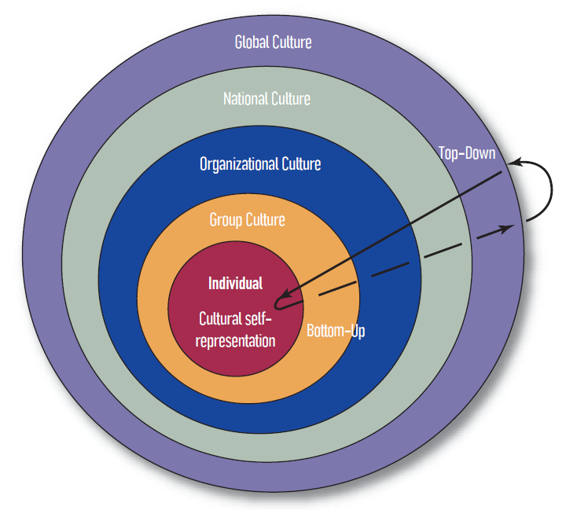

Slide 16
Consider the following facts
More than 100,000 U.S. companies are involved in worldwide ventures that are worth over $1 trillion; U.S. corporations have invested more than $400 billion abroad and employ more than 60 million overseas workers (Cascio, 2010).
One in five American jobs is tied directly or indirectly to international trade; foreigners hold top management positions in one-third of large U.S. firms, and Americans hold similar positions in one-fourth of European-based firms (Cascio, 2010).
The demise of the former Soviet Union and the development of the European Union has led to mass movements of people across borders.
Economic blocs have formed, enabling easy movement of the goods and people of one nation to another. These blocs include the North American and Central American Free Trade Agreements (NAFTA and CAFTA), the Southern Cone Common Market (MERCOSUR), the European Union (EU), the Association of Southeast Asian Nations (ASEAN), and the Economic Community of West African States (ECOWAS) (Aguinis & Henle, 2002).
Hermans and Kempen (1998) have dubbed this the “West versus the Rest” mentality. Not surprisingly, attempts to apply American theories to non-American situations are not always successful.
Notes:
Consider the following facts:

Slide 17
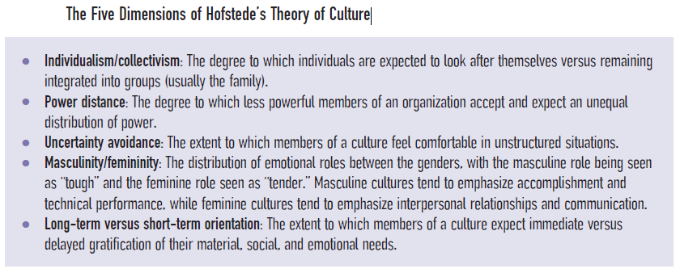
Some Theories of Cultural Influence
Collectivist culture - a culture that values the group more than the individual.
Individualist culture - a culture that values the individual more than the group.
by Dutch researcher Geert Hofstede

Slide 18
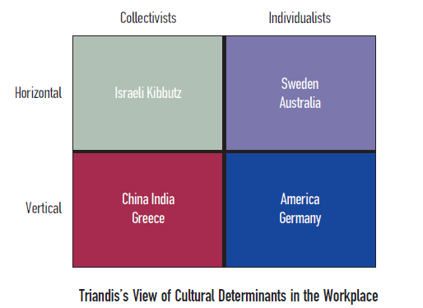
Triandis’s Theory
Horizontal culture - a culture that minimizes distances between individuals.
Vertical culture - a culture that accepts and depends upon distances between individuals.

Slide 19
Individual differences
Individual differences are the dis-similarities between or among two or more people.When Wilhelm Wundt was studying the sensations and reactions of people, his student James McKeen Cattell discovered that there were differences in people.
He developed a mental test, an instrument designed to measure a subject’s ability to reason,plan, and solve problems;an intelligence test, as a way of charting these differences.
Since the subject matter of this research was differences, the scientific study of differences became known as differential psychology.
Intelligence The ability to learn and adapt to an environment; often used to refer to general intellectual capacity, as opposed to cognitive ability or mental ability, which often refer to more specific abilities such as memory or reasoning.

Slide 20
He worked with Francis Galton, cousin of Charles Darwin for several years and expanded the number of inherited characteristics.
After returning to America, he used the mental test to measure the intelligence of incoming college students which he believed that would help the students to choose curricula and predict their successful completion of college.
He developed methods of measuring mental ability (capacity to reason, plan and solve problems) placing it on a scale or metric and the actual measurement of abilities became known as psychometric.
Several were aware of Cattell’s work in measuring intelligence. While Freud and other psychologists focused on the pathological aspects, pioneers of differential psychology were interested in the mental abilities of normal people.
Alfred Binet was measuring the mental abilities of French school children.

Slide 21
Lewis Terman was conducting similar studies in California with a translation of Binet’s test.
Hugo Munsterberg was measuring the abilities of trolley drivers in order to predict the likelihood of accidents.
When the US entered the First World War in 1917, leading industrial psychologists of the time persuaded the army to use an intelligence test to screen recruits and determine who should attend officers’ candidate school.
Measuring individual differences is different from experimental psychology which usually experiments with how all people are alike in their response to a stimulus and looks outside the individual to the stimulus as a way to explain behaviour, whereas differential psychology is person centered looking for qualities or characteristics with the person which helps us to understand the behaviour.

Slide 22
In the past, the applied aspects of I-O psychology depended on differences to predict things like job success, job satisfaction and counterproductive work behaviour. Now it considers factors like organizational practices, team characteristics, physical work and work environment design and even broad cultural influences.
The attributes often measured was some form of intelligence or cognitive ability which is used to acquire knowledge, solve problems and apply reason to situations. The abbreviation for general mental ability is g, the nonspecific capacity to reason, learn and solve problems in any of a wide variety of ways and circumstances.
Present day work psychologists consider individual difference in physical abilities, personality, interests, knowledge and emotions in addition to cognitive abilities.

Slide 23
Fundamental assumptions to apply the individual difference model
Adults have a variety of attributes (e.g., intelligence, personality, interests), and the levels of these attributes are relatively stable over a reasonable time period (several years).
People differ with respect to these attributes (i.e., there are “individual differences”), and these differences are associated with job success.
The relative differences between people on these attributes remain even after training, job experience, or some other intervention.
Different jobs require different attributes.
These attributes can be measured.

Slide 24
Human abilities
In 1950s, Edwin Fleishman associated mental and physical abilities to human performance including work performance and published a list of comprehensive 52 abilities or taxonomy (an orderly, scientific system of classification) divided into three broad categories of cognitive, physical and perceptual - motor abilities (physical attributes that combine the senses like seeing and smelling with motion like coordination and dexterity), which did not cover personality (an individual’s behavioural and emotional characteristics, generally found to be stable over time and in a variety of circumstances, an individual’s habitual way of responding), affect (the conscious, subjective aspect of emotion) or interest (preferences or likings for broad ranges of activities).

Slide 25
Cognitive abilities
Intelligence, IQ, cognitive ability and mental ability are often considered synonyms to one another, though IQ is a historical term and not longer has a scientific meaning, it is still being used by the general public.
Different cultures have different views of who is an intelligent person.
Almost every job requires some active manipulation of information and the greater the amount of information that needs to be manipulated, the more important g becomes.
A meta analysis in 2004 demonstrated that if the information processing demands of a job are high, a person with lower g is less likely to be successful than a person with higher g which does not mean that high g guarantees success on that job. Depending on the requirements like communication skills, interpersonal skills or certain personality skills, even a person with high g might fail.

Slide 26
In most of the Western countries, g is as important as it is in the US.
Researchers have observed that intelligence continues to rise over time and individuals appear to be more and more smarter through life span and new generations appear to be smarter than their parents. (Flynn effect Phenomenon in which new generations appear to be smarter than their parents by a gain of 15 points in average intelligence test score per generation; named after the political scientist who did extensive research on the topic.)
These differences from generation to generation may be due to better health care, better nutrition, increased schooling, better education parents and even an increasingly complex environment.
Within the generation, however, g appears to be stable.

Slide 27
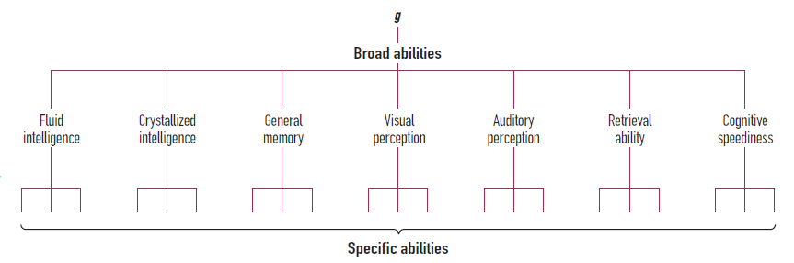
Specific cognitive abilities beyond g -Carroll’s Hierarchical model

Slide 28
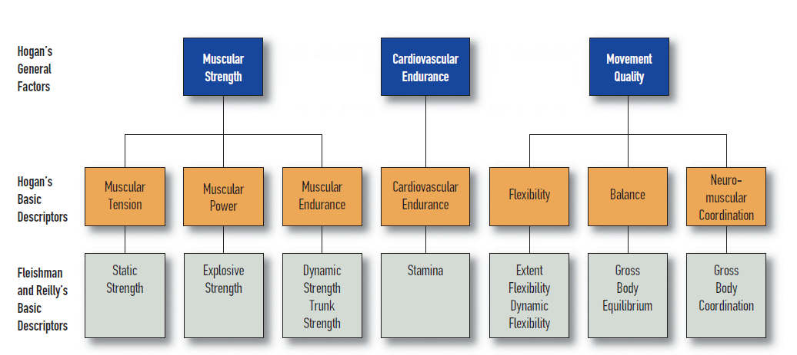
Hogan’s theory

Slide 29
Classification of Hogan’s abilities
Hogan’s theory insists that seven physical abilities are commonly required for most of the jobs.
If for a job requiring physical abilities, women can’t apply for get offered due to their poor stamina.
Sensory abilities are the physical functions of vision, hearing, touch, taste, smell and kinesthetic feedback.
To prevent employers from using a disability as an excuse to reject an application who is capable of performing a job, the Americans with Disability Act 1990 forbids them to ask about test areas such as sensory or physical abilities that may be considered as disabilities until after they are made a job offer to the candidate.
Psychomotor abilities sometimes called as sensorimotor or just motor abilities, deal with issues of coordination, dexterity and reaction time.

Slide 30
Personality and Work behaviour
Work-related behavior includes performance, absenteeism, counterproductive work behavior, and team effectiveness.
Barrick and Mount (2005) provide the following seven reasons why “personality matters in the workplace” and document those reasons using recent research:
1. Managers care about personality. In hiring decisions, they weigh personality characteristics as heavily as they do intelligence.
2. Many research studies show the importance of various personality measures in predicting both overall job performance and specific aspects of performance. Personality addresses the “will do” aspects of performance, while intelligence addresses the “can do” aspects of performance.
3. When we combine personality characteristics (rather than considering them one at a time), the relationship between personality and work performance becomes even stronger.

Slide 31
4. Personality measures improve the predictability of work performance over what would be found using only measures of intelligence or experience.
5. There are much smaller differences among age, gender, and ethnic minority subgroups on measures of personality than on measures of intelligence.
6. Personality measures predict not only near-term behavior (e.g., current job performance) but also distant outcomes such as career success, job and life satisfaction, and occupational status.
7. Personality measures predict a wide variety of outcomes that are important to managers, including counterproductive behavior, turnover, absenteeism, tardiness, group success, organizational citizenship behavior, job satisfaction, task performance, and leadership effectiveness.

Slide 32
The Big Five or Five Factor Model (FFM)
Big Five or the Five Factors model is a taxonomy of five personality factors composed of conscientiousness, extraversion, agreeableness, emotional stability and openness to experience.
According to this model, an individual’s personality can be described by where that individual falls on five dimensions, a useful acronym for the five scales is OCEAN. (N stands for neuroticism, the opposite of emotional stability.)
Personality can be defined in simplest terms as the typical way that an individual has of responding. It is considered to be a collection of traits because it is fairly stable, even though situations and circumstances might lead a person to behave in a way that is out of character with his or her overall personality.

Slide 33
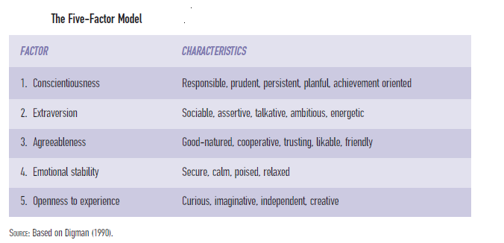

Slide 34
What seems to be true is that, although each of the five broad personality factors does predict successful/unsuccessful performance of certain behaviors, some combinations of the factors may be stronger predictors than any single factor. This introduces the idea of a functional personality at work , meaning that not just one factor predicts success, but a combination of factors.
For example, it is found that individuals who were high on conscientiousness, agreeableness, and emotional stability tended to have higher integrity. In this context, integrity means being honest, reliable, and ethical.
It is also found from a research that managers believed that a combination of conscientiousness, agreeableness, and emotional stability made applicants more attractive to managers who had hiring responsibilities.
A review confirmed the importance of conscientiousness across a variety of occupations and performance measures. Emotional stability also appeared to predict overall performance across occupations.
It is found that a combination of high emotional stability and high extraversion (which they labeled a “happy” or “buoyant” personality) led to higher performance for employees and supervisors at a health and fitness center. In another meta-analysis, it is found that low agreeableness, high extraversion, and low conscientiousness were related to accidents, both in occupational and traffic situations. These researchers suggested that individuals low on agreeableness have more difficulty managing interpersonal relations, including following group safety norms.

Slide 35
To summarize what we know about the relationship between personality and work behavior,
we believe the following conclusions can be drawn with confidence:
1. Personality differences play an important role in work behavior independent of the role played by cognitive ability (Mount & Barrick, 1995; Murphy, 1996).
2. Personality is more closely related to motivational aspects of work (e.g., effort expenditure) than to technical aspects of work (e.g., knowledge components). Personality is more likely to predict what a person will do, and ability measures are more likely to predict what a person can do (Campbell, 1990a; Mount & Barrick, 1995).
3. The FFM is a good general framework for thinking about important aspects of personality (Digman, 1990; Guion, 1998; Lubinski, 2000).
4. The more relevant and specific the work behavior we are trying to predict, the stronger the association between personality and behavior (Mount & Barrick, 1995).
5. Conscientiousness is best considered a combination of achievement and dependability. Achievement will predict some behaviors (e.g., effort) and dependability will predict other behaviors (e.g., attendance) (Hough, 1992; Moon, 2001; Mount & Barrick, 1995; Stewart, 1999).
6. Conscientiousness (along with its constituent factors achievement and dependability) has widespread applicability in work settings. It is possibly the most important personality variable in the workplace, and it may be the equivalent of “g” in the noncognitive domain (Schmidt & Hunter, 1992).

Slide 36
Additional Attributes
Skills Practiced acts, such as shooting a basketball, using a computer keyboard, or persuading someone to buy something.
People skills or the other non technical skills widespread than technical skills are negotiating skills, communication skills and conflict resolution skill.
Knowledge can be defined as “a collection of discrete but related facts and information about a particular domain. It is acquired through formal education or training, or accumulated through specific experiences”. Knowledge supports skill development, and it comes in many varieties.
Tacit knowledge is action oriented, goal-directed knowledge, acquired without direct help from others; colloquially called street smarts.
Procedural knowledge is the familiarity with a procedure or process; knowing “how.”
Declarative knowledge is understanding what is required to perform a task; knowing information about a job or job task.

Slide 37
I-O psychologists talk about combination of knowledge, skills, abilities and other personality characteristics in terms of competencies.
Competency is defined as “sets of behaviors that are instrumental in the delivery of desired results or outcomes”. They are sets of behaviors, usually learned by experience, that are instrumental in the accomplishment of desired organizational results or outcomes.
Abilities can be defined and measured in the abstract, as can personality characteristics. But competencies only have meaning in the context of organizational goals.
Emotional intelligence (EI) is a proposed kind of intelligence focused on people’s awareness of their own and others’ emotions.EI can be defined as “the ability to carry out accurate reasoning about emotions and the ability to use emotions and emotional knowledge to enhance thought”.
Proposed by Howard Gardner through interpersonal and intrapersonal intelligence and popularized by Goleman

Slide 38
Job analysis and performance
I-O psychologists have devoted a great deal of their research and practice to understanding and improving the performance of workers. All of us who have participated in a work group have observed differences in the performance of group members. Some perform at a very high level, whereas others perform less effectively:Research has shown that the ratio of the productivity of the highest performer to the lowest performer in jobs of low difficulty ranges from 2:1 to 4:1, while in jobs of high difficulty this ratio can be as much as 10:1
Attributes or the psychological variables help us in predicting the worker success or job performance.

Slide 39
Campbell’s model of Job performance
Following variables have been used as measures of performance by Campbell, et. al (1993)
Time to complete a training course might be constrained by how much time the worker can be away from the workplace.
Number of pieces produced is affected by the technology and equipment used by that worker.
Total days absent does not distinguish between excused and unexcused absences, sick days, personal days, or vacation days.
Total value of sales will be affected by discounts, territory, competition, marketing promotions, or the value of the products the employee is assigned to sell.
Promotion rate within an organization will be affected by the turnover rate in that organization.

Slide 40
Some important terms related to job performance are:
Performance - actions or behaviors relevant to the organization’s goals; measured in terms of each individual’s proficiency.
Effectiveness - evaluation of the results of performance; often controlled by factors beyond the actions of an individual.
Productivity - ratio of effectiveness (output) to the cost of achieving that level of effectiveness (input).

Slide 41
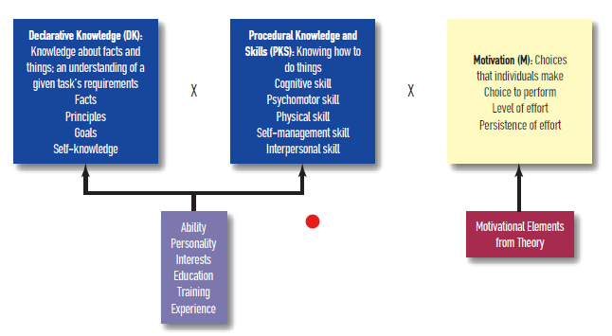
Campbells’ determinants of Job performance

Slide 42
Declarative knowledge (DK) - Understanding what is required to perform a task; knowing information about a job or task.
Procedural knowledge and skill (PKS) - Knowing how to perform a job or task; often developed through practice and experience.
Motivation (M) - Concerns the conditions responsible for variations in intensity, persistence, quality, and direction of ongoing behavior.
Determinants of performance - Basic building blocks or causes of performance, which are declarative knowledge, procedural knowledge, and motivation.
Performance components - Components that may appear in different jobs and result from the determinants of performance; John Campbell and colleagues identified eight performance components, some or all of which can be found in every job.

Slide 43
Based on extensive research with army enlisted personnel, Campbell developed a hierarchical model of job performance (Campbell, 1990a; Campbell, McHenry, & Wise, 1990). He postulated three direct determinants of job performance: declarative knowledge (DK), procedural knowledge and skill (PKS), and motivation (M). By determinants, he means the basic building blocks or causes of performance.
Campbell’s model also proposes that many variables (ability, personality, interest, training and experience, motivators) have an indirect effect on performance.These variables can affect performance only by changing the level of DK, PKS, or M. For example, increased training or experience will affect performance by increasing DK or PKS; incentives for performance will affect performance by increasing M.
There is one other important aspect to Campbell’s model: actual performance components. DK, PKS, and M are determinants of performance, but they are not behaviors.

Slide 44
Campbell’s research identified eight basic performance components, some or all of which can be found in every job. When we combine the eight performance components with the three direct determinants of performance and the various indirect determinants of performance, we get an expanded model Although the model specifies eight distinct performance components, not all components will appear in all jobs. Nevertheless, the model allows performance in any job to be broken into all or some subsets of these components.
Campbell asserted that three of the performance components—core task proficiency, demonstrating effort, and maintaining personal discipline—are essential at some level for every job.
Campbell’s expanded model occupies a valuable middle ground between a view of performance as some unitary entity or a single broad factor—a view that contradicts what we can observe at work every day—and an equally ineffectual view that says every job is different and there can be no general understanding of job performance beyond the particular job being considered.

Slide 45
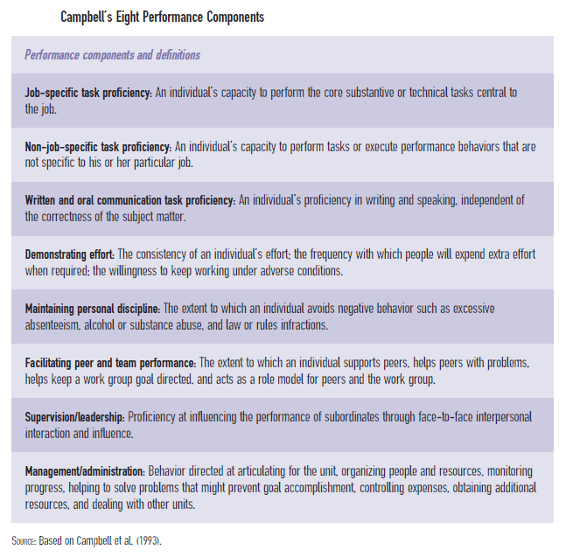

Slide 46
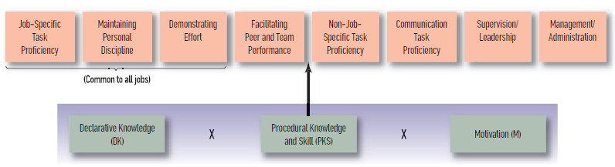
Campbell’s extended model

Slide 47
Maximum & Typical performance
Typical performance might be characterized by a worker putting in 70 percent effort for eight hours; maximum performance, in contrast, might be that same worker putting in 100 percent effort for four (or even eight!) hours.
The implication is that these are somehow different types of performance. Maximum performance can be thought of as the very best a person can do—exerting 100 percent effort, leaving nothing in reserve. Typical performance is everything else.
Furthermore, it is not clear how long a worker can demonstrate maximum performance.
When first introduced as a concept by Sackett and colleagues (1988), maximum performance was thought to be controlled largely by abilities (e.g., intelligence) and typical performance by a combination of ability and motivation.

Slide 48
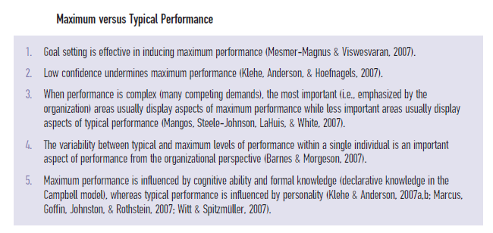

Slide 49
Criterion Deficiency and Contamination
Criterion deficiency is a situation that occurs when an actual criterion is missing information that is part of the behavior one is trying to measure.
Criterion contamination is a situation that occurs when an actual criterion includes information unrelated to the behavior one is trying to measure.
A collective measure of all relevant aspects of job performance would be called the ultimate criterion, but since we can never reliably measure all aspects of performance, we settle for an actual criterion.

Slide 50
Campbell’s model of performance, by focusing on worker behaviors and the extent to which the worker has complete control over outcomes, protects against criterion contamination.
By providing eight of the most important and unique aspects of performance in most jobs, it also protects against criterion deficiency.
It is important to keep in mind that probably not a single job has only one behavior that defines successful performance. Just as the predictor side of the basic work prediction equation is complex—requiring a consideration of many different combinations of human attributes such as intelligence, personality, and motivation—so is the criterion side, requiring a consideration of many different aspects of performance.
Workers call on many attributes to perform their jobs, and each of these human attributes (predictors) is associated with certain aspects of performance.

Slide 51
Task Performance versus Organizational Citizenship Behavior
When performance is discussed, it is usually in the context of one or more tasks that define a job. These tasks can be found in job descriptions, training materials, and so forth. But there is more to work life than just assigned tasks.
But, when it comes to job performance, there are two kinds of workers. The first do exactly what they are assigned and no more. They avoid putting themselves out for co-workers or expending any extra effort on behalf of the organization.
The second type of worker is the exact opposite. These workers go out of their way to make life easier for their co-workers and supervisor, with the result that they are often described as “exceeding expectations.” The term “expectations” is the key.
Organ and his colleagues (Smith, Organ, & Near, 1983) labeled this type of behavior—going beyond what is expected—organizational citizenship behavior (OCB) and developed questionnaires to assess that behavior in workers.

Slide 52
The questionnaires seem to assess two separate aspects of OCB, altruism—helpful behaviors directed toward individuals or groups within the organization, such as offering to help a co-worker who is up against a deadline—and generalized compliance—behavior that is helpful to the broader organization, such as upholding company rules (Organ & Ryan, 1995).
It appears that OCB is closely associated with the fact that work is a joint rather than an individual effort, considered more important when work tasks required collaboration among workers or within work teams. and a social phenomenon.
Task performance is defined as “the proficiency with which job incumbents perform activities that are formally recognized as a part of their job”
OCB is more informal and is defined as “behaviors that go beyond task performance and technical proficiency, instead supporting the organizational, social, and psychological context that serves as the critical catalyst for tasks to be accomplished”

Slide 53
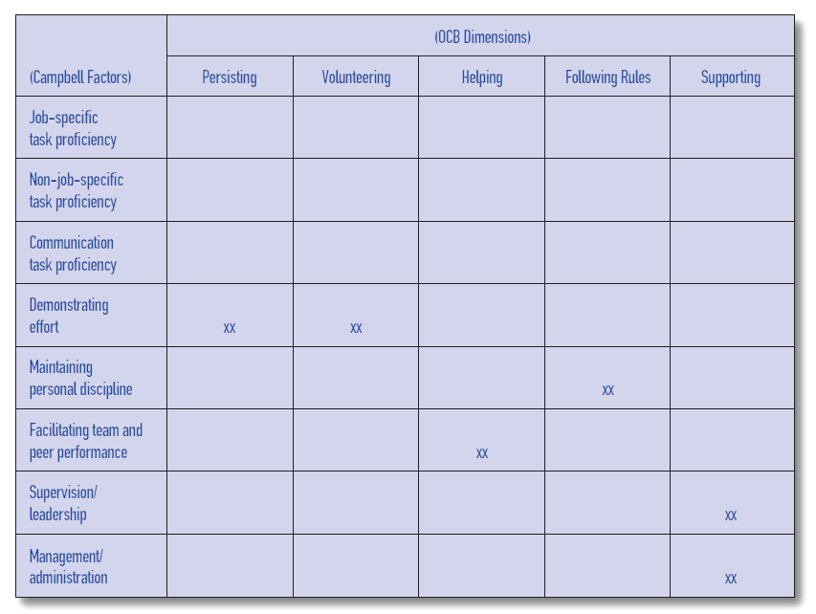
The emergence of measures of personality and emotional intelligence are considered as the new “favorite” predictor variables and OCB is the new “favorite” measure of performance to be studied by I-O psychologists.
Matrix with OCB Dimensions and Campbell’s Performance Components is given below.

Slide 54
Leveraging organizational goals through human attributes that lead to high levels of worker performance. But, there are constraints to this leveraging process, and they can be collected under the heading counterproductive work behavior (CWB).
Counterproductive behavior is defined as “voluntary behavior that violates significant organizational norms and in so doing, threatens the well-being of the organization, its members, or both”.
Three common counterproductive behaviors are dishonesty, absenteeism, and sabotage.
Dishonesty - Employee theft of goods and theft of time (arriving late, leaving early, taking unnecessary sick days) or dishonest communications with customers, co-workers, or management.
Absenteeism - Type of counterproductive behavior that involves failure of an employee to report for or remain at work as scheduled.
Sabotage - Acts that damage, disrupt, or subvert the organization’s operations for personal purposes of the saboteur by creating unfavorable publicity, damage to property, destruction of working relationships, or harming of employees or customers.

Slide 55
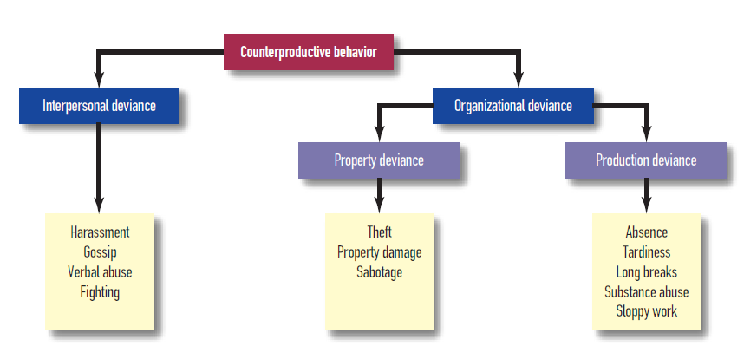

Slide 56
Adaptive performance
Adaptive performance - Performance component that includes flexibility and the ability to adapt to changing circumstances.
A changing work environment puts increased importance on workers who are flexible and able to adapt to changing circumstances.
Pulakos and colleagues cited the following circumstances of today’s workplace that favor this adaptability:
Changing technologies alter work tasks.
Mergers, downsizing, and corporate restructuring require employees to learn new skills.
Globalization requires individuals to work in different cultures.
Pulakos and colleagues (2000) proposed adaptive performance as a valid performance component that can be further divided into eight types of adaptive behavior
Bartram (2005) has tried to combine some of the performance categories we have outlined above into a broader model of performance that he calls the “Great Eight” model of competencies. These competencies, which cover Campbell’s dimensions, OCB, and the adaptability concept of Pulakos.
Expert performance - Performance exhibited by those who have been practicing for at least 10 years and have spent an average of four hours per day in deliberate practice.

Slide 57
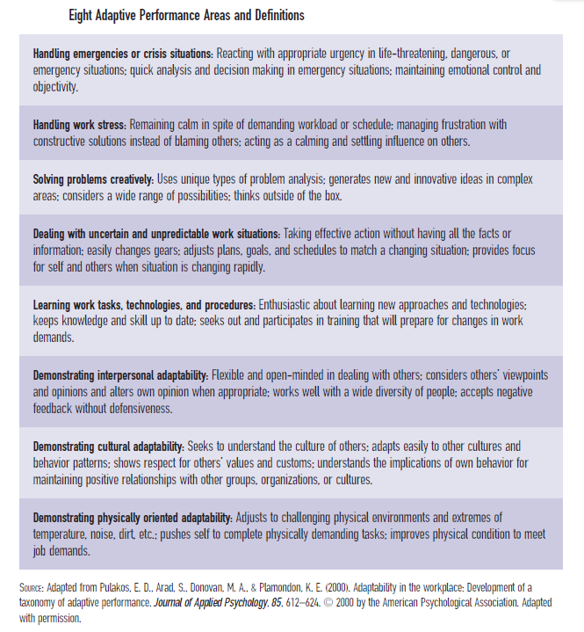

Slide 58
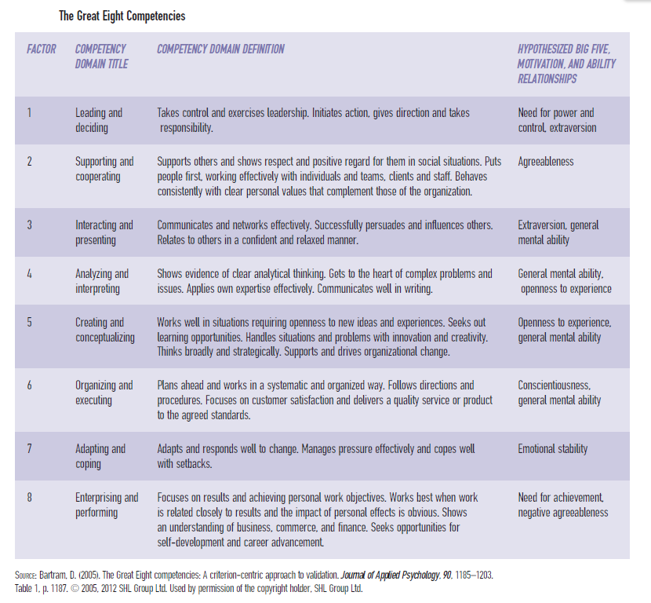

Slide 59
Types of Performance Measures
Most I-O literature distinguishes among different types of performance indicators; these indicators are concerned with how performance is indexed, not the nature of that performance (e.g., OCB, CWB, task performance). Three different categories have been suggested:
Objective performance measure - Usually a quantitative count of the results of work, such as sales volume, complaint letters, and output.
Judgmental measure - Evaluation made of the effectiveness of an individual’s work behavior; judgment most often made by supervisors in the context of a performance evaluation.
Personnel measure - Measure typically kept in a personnel file, including absences, accidents, tardiness, rate of advancement, disciplinary actions, and commendations of meritorious behavior.

Slide 60
Job analysis
Job analysis - Process that determines the important tasks of a job and the human attributes necessary to successfully perform those tasks.
The purpose of a job analysis is to understand what the important tasks of the job are, how they are carried out, and what human attributes are necessary to carry them out successfully. In short, job analysis is an attempt to develop a theory of human behavior about the job in question.
This theory will include performance expectations (properties of the job in the context of the organization’s expectations) as well as the required abilities, knowledge, experience, skill, and personal characteristics necessary to meet those expectations.
The results of a job analysis can be used for many different purposes, including those addressed below.
Job Description
Recruitment
Selection
Training
Compensation
Job assignment / Promotion
Job design
Workforce reduction / restructuring
Criterion development
Performance evaluation
Litigation

Slide 61
Types of job analysis
The purpose of a job analysis is to combine the task demands of a job with our knowledge of human attributes and produce a theory of behavior for the job in question.
There are two ways to approach building that theory. One is called the work- or task-oriented job analysis; this approach begins with a statement of the tasks the worker actually performs, the tools and machines used, and the work context.
A second method is called the worker-oriented job analysis; this approach begins by focusing on the attributes and characteristics of the worker necessary to accomplish the tasks that define the job (Brannick et al., 2007).
Since both approaches end up in the same place—a statement of KSAOs—neither can be considered the “right” way to conduct a job analysis.

Slide 62
Regardless of which approach is taken, the next step in the job analysis is to identify the attributes—the KSAOs we covered in Chapter 3 on individual differences—that an incumbent needs for either performing the tasks or executing the human behaviors described by the job analysis. KSAOs can be defined as follows:
Knowledge: “a collection of discrete but related facts and information about a particular domain . . . acquired through formal education or training, or accumulated through specific experiences” (Peterson, Mumford, Borman, Jeanneret, & Fleishman, 1999, p. 71)
Skill: a practiced act, or the capacity to perform a specific task or job duty (Gatewood, Feild, & Barrick, 2011; Harvey, 1991)
Ability: the stable capacity to engage in a specific behavior
Other characteristics: personality variables, interests, training, and experience

Slide 63
How job analysis is done?
Regardless of the approach the job analyst decides to use, information about the job is the backbone of the analysis, and there are many ways to get it. The more information and the more ways the analyst can collect that information, the better the understanding of the job.
A term frequently used in job analysis is subject matter expert (SME). An SME is usually an incumbent worker or that worker’s supervisor. The person will have accumulated the “expertise” in the “subject matter” of the job by actually performing the job tasks under investigation.
Some common methods of job analysis include the following:
Observation. This was perhaps the first method of job analysis I-O psychologists used. They simply watched incumbents (SMEs) perform their jobs and took notes. Sometimes they asked questions while watching, and sometimes they even performed job tasks themselves.

Slide 64
Interviews. It is important to supplement observation by talking with incumbents, either at the worksite or in a separate location. These interviews are most effective when structured with a specific set of questions based on observations, other analyses of the types of jobs in questions, or prior discussions with HR reps, trainers, or managers knowledgeable about the jobs.
Critical incidents and work diaries. I-O psychologists have used other techniques to capture important information about jobs.
Critical incident technique - Approach in which subject matter experts are asked to identify critical aspects of behavior or performance in a particular job that led to success or failure.
Work diary - Job analysis approach that requires workers and/or supervisors to keep a log of their activities over a prescribed period of time.
Questionnaires/surveys. Expert incumbents or supervisors (SMEs) often respond to questionnaires or surveys as part of a job analysis. These questionnaires include task statements in the form of worker behaviors. Based on their experience, SMEs are asked to rate each statement on a number of dimensions such as frequency of performance, importance to overall job success, and whether the task or behavior must be performed on the first day of work or can be learned gradually on the job.

Slide 65
Job Analysis: Newer Developments
In the 1980s and 1990s, the introduction of computers and other technology-based information networks into the workplace clearly revolutionized planning, production, and distribution. But this technology has introduced another, less obvious, opportunity: the opportunity to monitor work processes, both actively and passively.
Electronic performance monitoring - Monitoring work processes with electronic devices; can be very cost effective and has the potential for providing detailed and accurate work logs.
Example: Consider the phone call you make to ask a question about your telephone bill. A recorded message will tell you that your “call may be monitored for quality control purposes.” That means that the performance of the agent or representative with whom you are talking is being monitored and “critical incidents” in success and failure can be identified.

Slide 66
Cognitive task analysis - A process that consists of methods for decomposing job and task performance into discrete, measurable units, with special emphasis on eliciting mental processes and knowledge content.
Think-aloud protocol - Approach used by cognitive psychologists to investigate the thought processes of experts who achieve high levels of performance; an expert performer describes in words the thought process that he or she uses to accomplish a task.
Cognitive task analysis is time consuming and requires a good deal of expertise to do well. As a result, it may be a luxury for low-level jobs or jobs in which the cost of a mistake is small. But for critical positions where the consequence of an error is extremely high, cognitive task analysis may be a useful addition to the job analysis arsenal. DuBois (1999) suggested that employers consider the following indicators to determine whether a cognitive task analysis may be worthwhile:
There are persistent performance problems.
There are costly errors or accidents.
Training is difficult to transfer to job behavior.
Achieving high levels of performance takes a long time.
Personality-Related Position Requirements Form (PPRF) - Job analysis instrument devoted to identifying personality predictors of job performance.

Slide 67
Dictionary of Occupational Titles (DOT) - Document that includes job analysis and occupational information used to match applicants with job openings; a major purpose of the DOT was, and still is, for use in occupational counseling.
Task-based descriptions of occupations provide limited value in work environments with shifting job boundaries. Further, each revision of the DOT was expensive and time consuming. A decision was made to change both the format and the content of the DOT (Dunnette, 1999).
In 1995 the federal government introduced the concept of an electronic database to replace the DOT. The database was called the Occupational Information Network or O*NET.
Occupational Information Network (O*NET) - Collection of electronic databases, based on well-developed taxonomies, that has updated and replaced the Dictionary of Occupational Titles (DOT ).

Slide 68
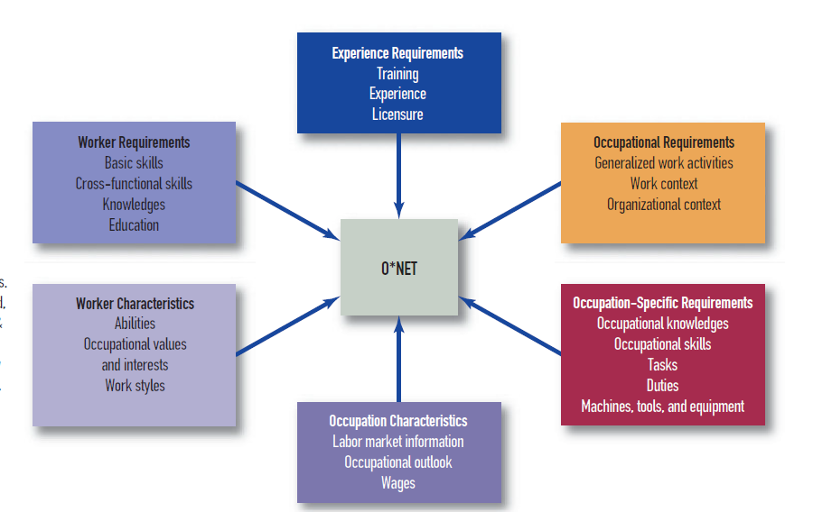

Slide 69
Not all jobs and job families have yet been entered into the O*NET databases, but when the system is complete, it is expected to meet at least the following needs:
Identifying occupational skill standards common to clusters of occupations, or job families.
Facilitating school-to-work transitions by linking educational programs to occupational standards.
Assisting laid-off workers in finding reemployment through job search assistance, labor market information, and training.
Assisting employers in building high-performance workplaces by providing information about the business practices associated with existing high-performance workplaces.
Competency modeling - Process that identifies the characteristics desired across all individuals and jobs within an organization; these characteristics should predict behavior across a wide variety of tasks and settings, and provide the organization with a set of core characteristics that distinguish it from other organizations.

Slide 70
Just as job analysis seeks to define jobs and work in terms of the match between required tasks and human attributes, competency modeling seeks to define organizational units (larger entities than simply jobs or even job families) in terms of the match between the goals and missions of those units and the competencies required to meet those goals and accomplish those missions.
Thus, competency modeling is a natural extension of the job analysis logic rather than a replacement for job analysis. It is competency modeling that has the power to connect individual behavior with organizational viability and profitability.
Like cognitive task analysis and the Personality-Related Position Requirements Form, competency modeling goes beyond traditional job analysis by recognizing that work and the workplace are in a state of rapid evolution.
Competency modeling is not without its critics. Much if not most of the criticism is about the definitions of competencies, although recent work (Bartram, 2005; Campion et al., 2011) addresses those issues. In addition, some have criticized the apparent lack of agreement between the results of traditional job analyses and those of competency modeling.

